Slide 1
How much intellectual property (IP) is in a cup of tea?
Magdaleen van Wyk & Dr Thandanani Cwele SSAIP & CIPC 15 September 2023

Slide 2
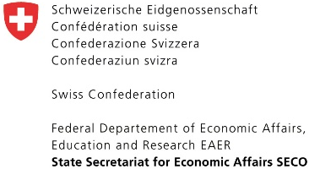
How much intellectual property in a cup of tea?
Thandanani Cwele
CIPC Patents and Designs Registry
Magdaleen van Wyk
Swiss-South African Intellectual Property Project
African Biotrade Festival 14 – 16 September 2023

Slide 3
background
SSAIP: Swiss-South African Intellectual Property Project
Outcomes:
Outcome A: National IP Policy strengthened through consultations and workshops and sui generis GI system development
Outcome B: IPR registration and administration entities provide efficient and user-friendly services
Outcome C: SMME supporting agencies and IPR entities promote protection and use of IPRs to potential users IPRs
Outcome D: Increased commercialization of IPRs as part of innovation process
CIPC: an agency of the Department of Trade, Industry and Competition
The CIPC was established in May 2011 by the Companies Act 78 of 2008.
Mandate:
To register companies and co-operatives.
To register intellectual property rights.
To maintain registers with regard to all of the above.
To conduct education and awareness on all of the above.

Slide 4
HOW MUCH ip IN A CUP OF TEA?
Traditional Knowledge
Copyright
Trade Secret
Trade Marks
Patents
Geographical indications
Designs
Plant Breeders Rights

Slide 5
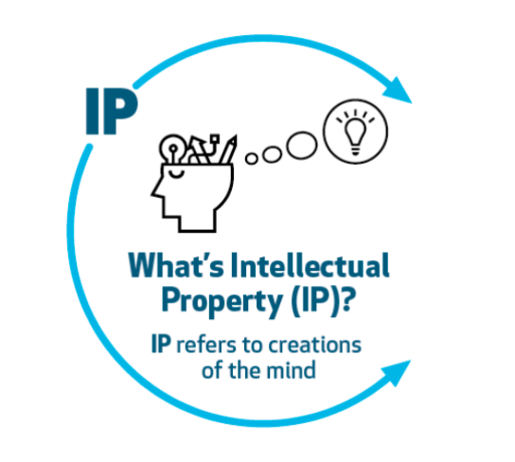
Intellectual WHAT?
IP refers to creations of the mind:
Inventions
Literary and artistic works
Symbols names, images, and designs used in commerce
www.onedaydesignchallenge.net

Slide 6
Forms of intellectual property
Traditional/Indigenous knowledge:
In the international space there are a number of definitions of TK and it can be understood to mean knowledge, know-how, skills and practices that are developed, sustained and passed on from generation to generation within a community, often forming part of its cultural or spiritual identity.
Legislation
National Environmental Management: Biodiversity Act, 2004 and Regulations (Act No. 10 of 2004) (NEMBA)
Protection, Promotion, Development and Management of Indigenous Knowledge Act, 2019 (Act No. 6 of 2019) (IKS Act) (Draft)
Intellectual Property Laws Amendment Act, 2013 (Act No. 28 of 2013) (IPLAA)

Slide 7
Forms of intellectual property
Copyright:
Copyright protects any original works you produce such as literary, musical or artistic works, films, sound recordings, broadcasts, programme-carrying signals and computer programmes.
Copyright means your original works cannot be copied, performed or shown without permission and if anyone uses your works or reproduces and distributes without your permission, they are breaking copyright law.
Can be used without permission is when it’s used for private study, as a quote, for teaching purposes and for reporting current news, as long as source and author are mentioned.
Legislation:
The Copyright Act 98 of 1978
The copyright of written works lasts for 50 years after death of the author.
The copyright of computer programs lasts for 50 years after the first copies were made available to the public.
For sound recordings, the copyright lasts for 50 years from the day the work was first broadcast.
For film, 50 years from the date the film was shown.
Copyright in a cup of tea:
Written materials and information on tea, websites etc.

Slide 8
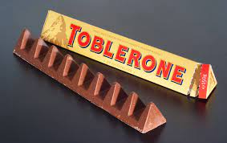
Forms of intellectual property
Trade marks:
A trade mark is a brand name, slogan or logo that identifies goods or services
Legislation:
Trade Marks Act 194 of 1993 – protected if it is registered.
Unregistered trade marks may be defended in terms of common law. Registering a trade mark results in a registration certificate which has legal status, allowing the owner of the registered trade mark the exclusive right to use that mark.
A registered trade mark can be protected forever, provided it is renewed every ten years
Trade marks in a cup of tea:
Sign capable of distinguishing the goods or services of one enterprise
used in the course of trade from those of other enterprises
A word or a combination of words, letters and numerals
May also consist of drawings, symbols, 3D features such as the shape
and packaging of goods, nonvisible signs such as sounds, fragrances
or colour shades used as distinguishing features
Image source: Toblerone - Wikipedia

Slide 9
Forms of intellectual property
Geographical Indications:
Geographical indications and appellations of origin are signs used on goods that have a specific geographical origin and possess qualities, a reputation or characteristics that are essentially attributable to that place of origin. Most commonly, a geographical indication includes the name of the place of origin of the goods.
Legislation:
Agricultural Products Standards Act, Act No 119 of 1990 (APSA)
The Liquor Products Act (Act No. 60 of 1989) (LPA)
The Merchandise Marks Act, Act No 17 of 1941 (MMA); and
The Trade Marks Act, Act No. 194 of 1993 (TMA)
GIs in a cup of tea:
Teas such as Rooibos tea from South Africa that have unique quality and flavour linked to their origin

Slide 10
Forms of intellectual property
Plant Breeders’ Rights:
New tea varieties adapted to local climate conditions or changing consumer tastes can receive plant variety protection
Legislation:
The Plant Breeders' Rights Act 15 of 1976
It intends to provide for a system whereunder rights relating to new varieties of certain kinds of plants may be granted and registered; for the protection of such rights.

Slide 11
Forms of intellectual property
Trade Secrets:
Trade secrets are IP rights on confidential information which may be sold or licensed.
Legislation
Trade secrets are not protected by specific legislation, but the misappropriation is considered unlawful—the legal basis has been contractual or fiduciary obligations.
South African courts consider the breach of trade secrets to be unlawful competition
In Harchris Heat Treatment v Iscor, the court established three requirements for an asset to be classified as a trade secret:
1) the information must not only relate to but also be capable of application in trade or industry;
2) the information must be secret or confidential
3) the information must, likewise objectively viewed, be of economic (business) value to the plaintiff.
Trade secrets in a cup of tea:
A secretly kept tea recipe, customer lists, sales tactics, marketing strategies, manufacturing process, etc.

Slide 12
Forms of intellectual property
Design:
Design rights protect the shape and appearance of a product or object.
There are two types of design – aesthetic design which relates to the outward appearance of a product, such as a canister and functional design which is something you’d use, like a tea pot.
Legislation
Designs Act No. 195 of 1993
The life span of the design right is 15 years for an aesthetic design and 10 years for a functional design.
Registering your design ensures that you have exclusive rights to use the design. If anybody tries to copy, sell or use the design without your permission, it means you’d have the right to take legal action.
Designs in a cup of tea:
The design of tea products, such as tea pots and cups, containers,
tea strainers and tea bags can be protected.

Slide 13
Patents
IP Questions to be addressed:
What are patents?
What is or isn't protected through patents?
How to get patent protection?
What to do with patent rights?

Slide 14
What are Patents?
Negative rights
- Right to exclude others from making, using, selling, offering for sale or importing the claimed invention
Limited-monopoly of 20 years.
Quid Pro Quo
- It is a requirement that a patent applicant must sufficiently disclose the invention
- Patent applications are published, even when they are not granted
- These publications are accompanied with more related information
“Disclose your invention”
“Give me time-limited monopoly”

Slide 15
What is or isn't protected through patents?
The following are not inventions
Discovery
Scientific method
Literary, dramatic, musical or artistic work
Scheme, rule or method of performing a mental act, playing a game or doing business
Computer program
Presentation of information
Method of treatment is excluded but substance used in a method of treatment – included
New
Inventive
Sufficiently disclosed
Machine
Product
Improvements thereof
Process

Slide 16
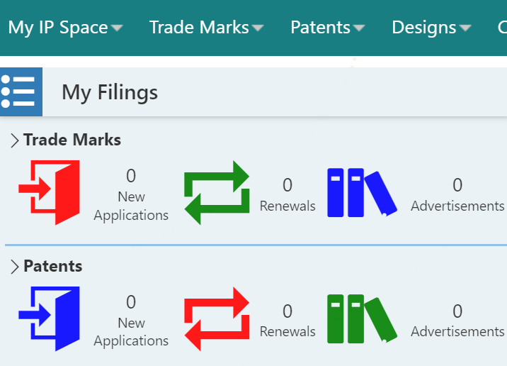
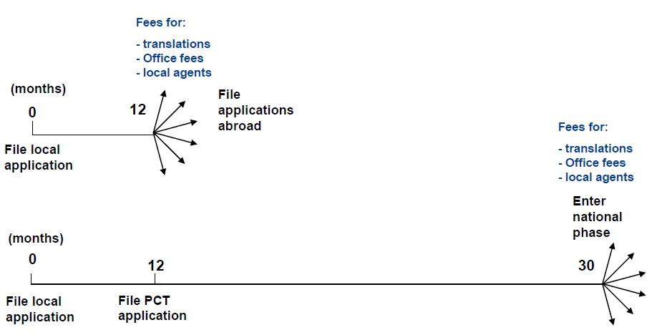
Patent routes to CIPC
Provisional
Complete
Route 1
continue to grant
Route 2
convention
Route 3
PCT
https://iponline.cipc.co.za/MyIPSpace/MyIPSpaceHome.aspx
Source: https://www.wipo.int/pct/en

Slide 17
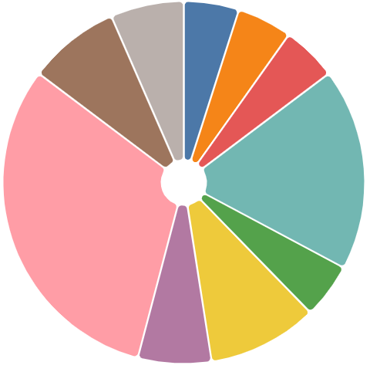
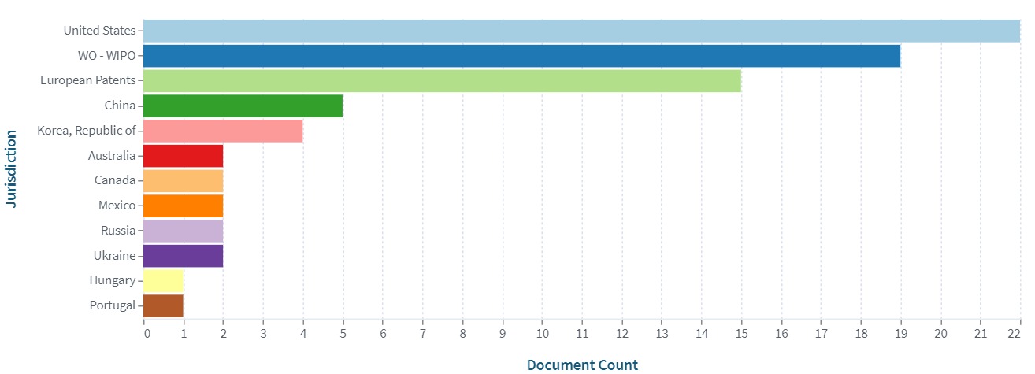
The infamous story of Pelargonium species
Umckaloabo is the root of a South African geranium, Pelargonium sidoides
Medicinal benefits:
Treatment of tuberculosis
Treatment of acute respiratory tract infections (i.e. bronchitis, sinusitis, tonsillitis, the common cold etc.)

Slide 18
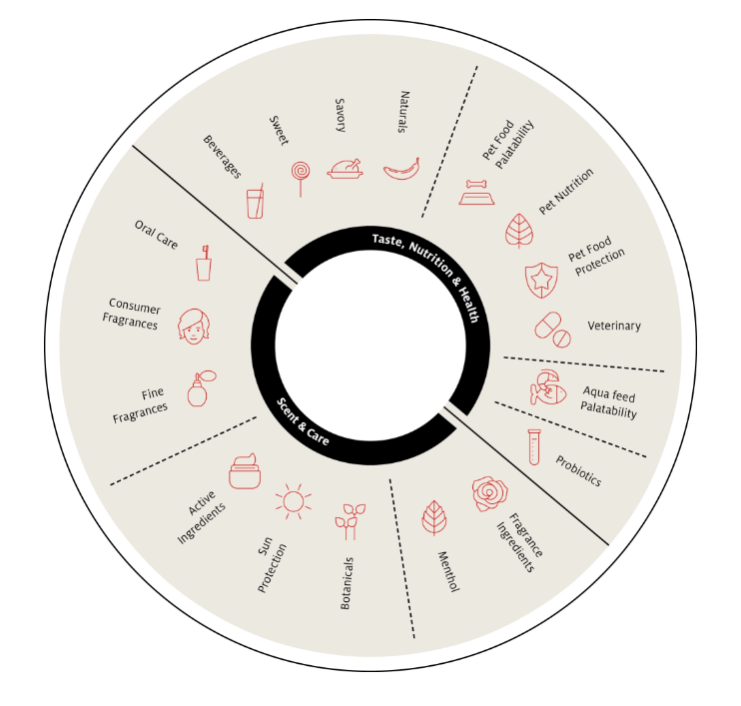
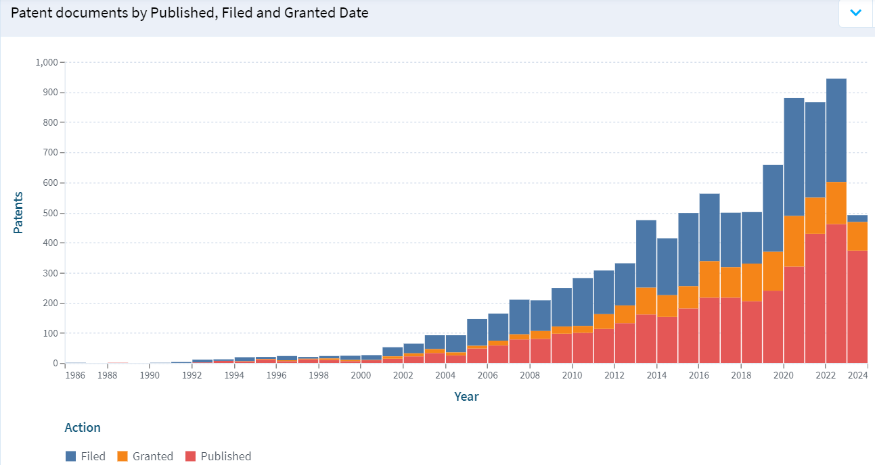
The famous story of Rooibos (Aspalathus linearis)

Slide 19
WHY IS IP IMPORTANT FOR BIOTRADE?
Some IP must be registered before/after certain research can be conducted.
Access and Benefit Sharing Agreement (ABS) – aims to highlight how third parties can access the “knowledge” of a community in respect of the genetic resource and sets out each party’s responsibility
The agreement should address how parties will apportion these benefits and how access will be provided and benefit shares (i.e. costs of IP registrations, payment of royalties etc.)
How can IP ‘add value’ to your business?
Increasing market value of the firm
Marketing
Exporting goods and services
Raising finances
Acquiring new technology and finding suppliers
Commercializing innovative product

Slide 20
Protecting IP is expensive?
IAP:
supports inventors and small businesses with limited financial resources protect their inventions and covert them to commercial assets.
matches selected beneficiaries with a volunteer patent attorney or agent to help them navigate the patent system at no cost.
Participating countries: Chile, Colombia, Ecuador, Kenya (2023), Morocco, Peru, the Philippines, Singapore (2023), South Africa (2017).
https://www.wipo.int/iap/en/participant_countries.html

Slide 21
Thank you

